Slide 1
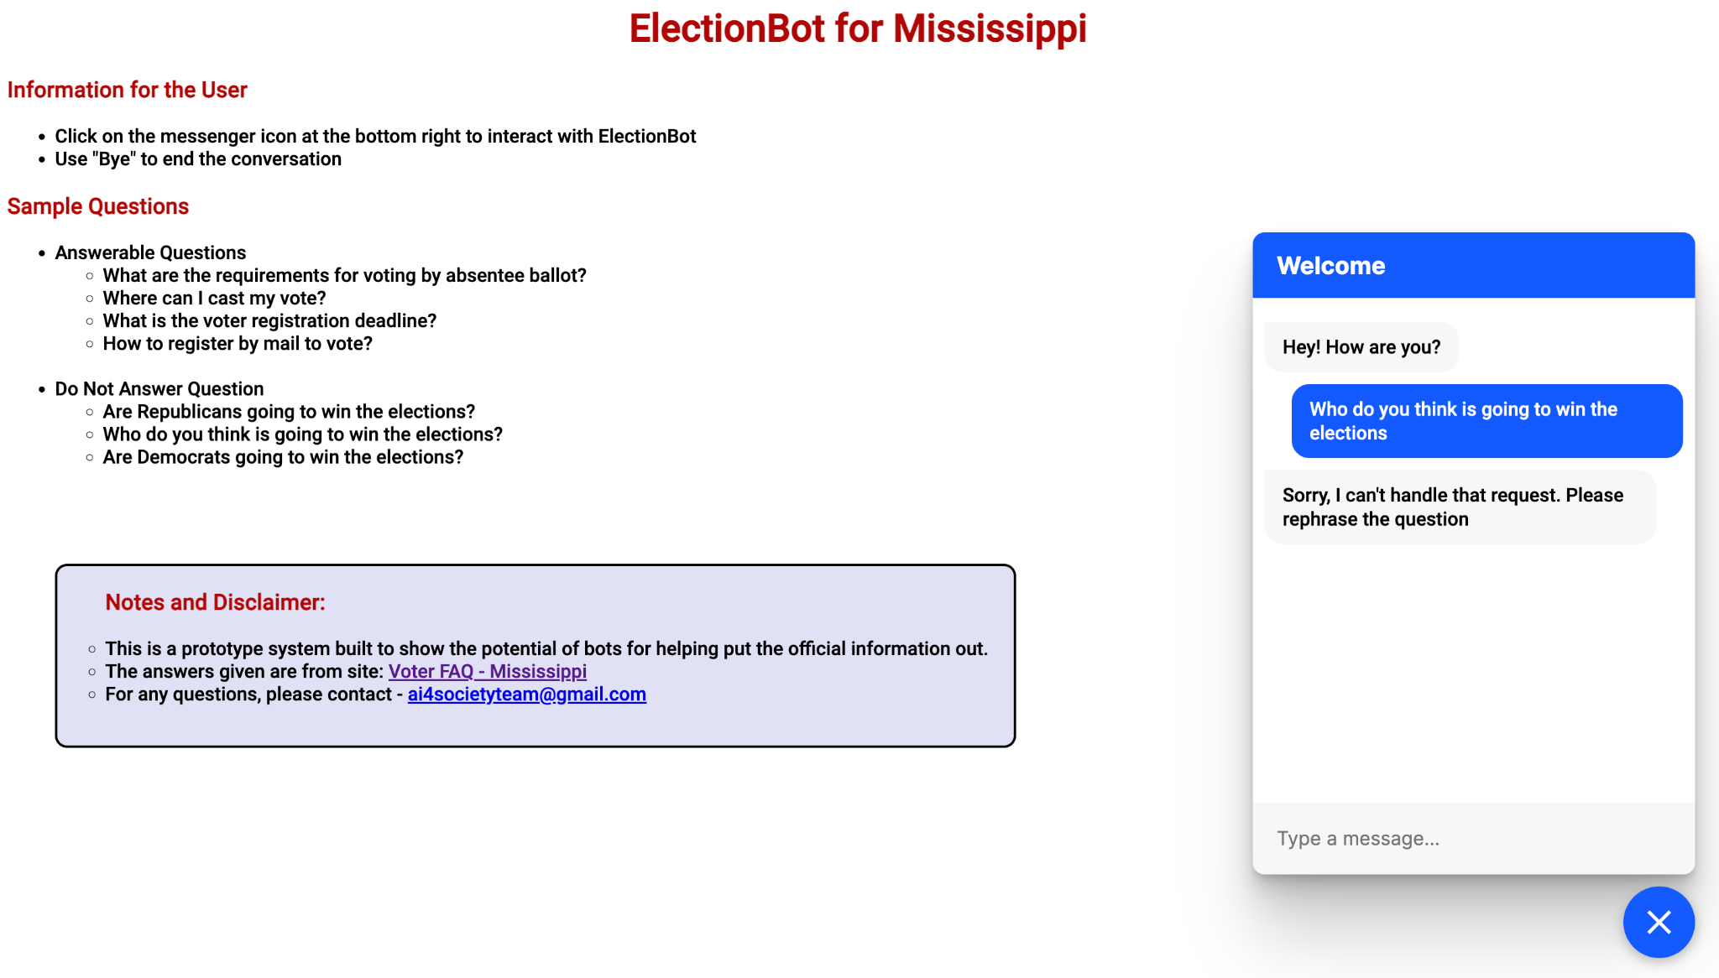
Election Chatbot for Mississippi
Problem: Building a FAQ chatbot for Mississippi state elections to provide ease of user interaction
Approach:
Extracting Question-Answer pairs from Mississippi state website regd elections (.csv).
Each question is paraphrased to 5 similar sentences using BART.
RASA makes use of the CSV to automatically build the chatbot.
The chatbot is eventually deployed on Alexa device and website.
Test Case –
Input: What is the primary election date for Mississippi
Output: June 7
Input: Whom should I vote for?
Output: I cannot answer this question.
Figure 1. The chatbot website demonstrating an example of do-not-answer strategy.

